Slide 1

Temp Controlled Fan
Group No: 08
Group Members:
Lt Farhan Abrar Kabir(170214136)
Flg Offr Sazid Shariar(201914004)
Md. Abdul Al Emon(201914049)

Slide 2
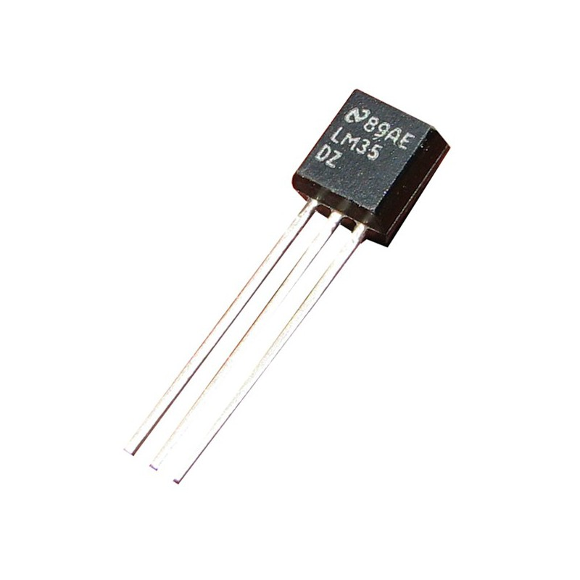
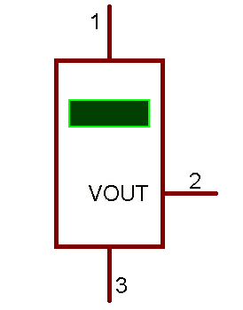
LM35 Temperature Sensor
Device : LM35
Library : NETCAD
Price : 71-85 /-
Description : Precision Centigrade Temperature Sensor (-55C to 155C

Slide 3
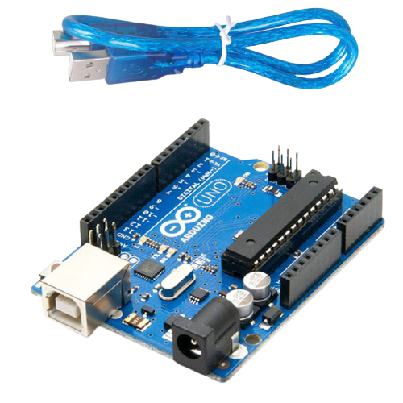
Arduino Uno R3
Device : Arduino Uno R3
Library : ArduinoUno TEP
Price : 750/-
Description :

Slide 4
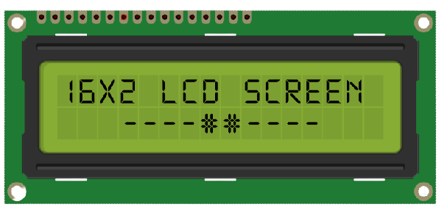
16 x 2 LCD Display
Device : LM016L
Library : Display
Price : 160 /-
Description : 16 X 2 Alphanumeric LCD

Slide 5
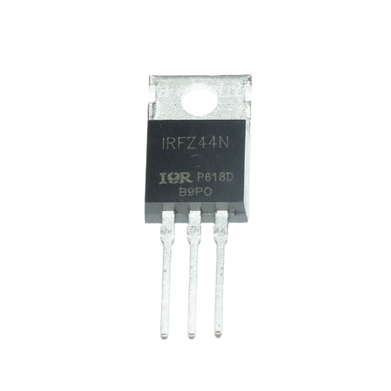

IRFZ44N Mosfet
Device : IRFZ44N
Library : IRPOWER
Price : 35-45 /-
Description :

Slide 6
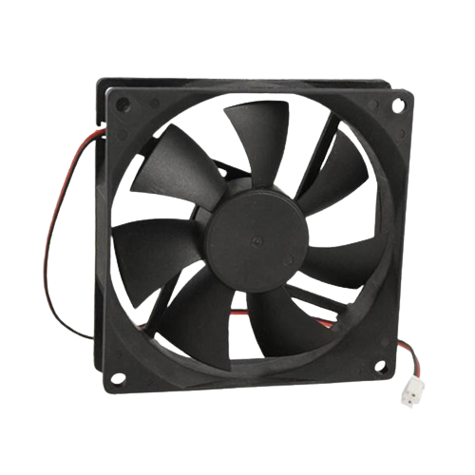

12V DC FAN
Device : FAN-DC
Library : MOTORS
Price : 75 /-
Description :

Slide 7
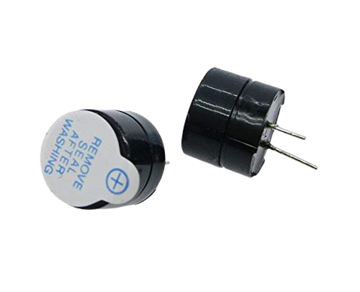

12V Buzzer
Device : BUZZER
Library : DEVICE
Price : 25 /-
Description :

Slide 8
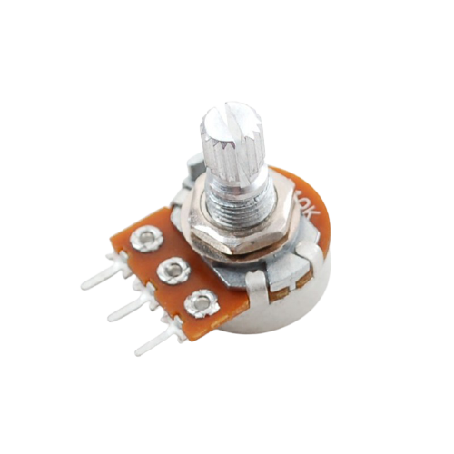

10k Ohm Potentiometer
Device : 3005p-1-103
Library : TRIMMERS
Price : 20 /-
Description : POT 10K OHM ¾ INCH RECT WW SL MT

Slide 9
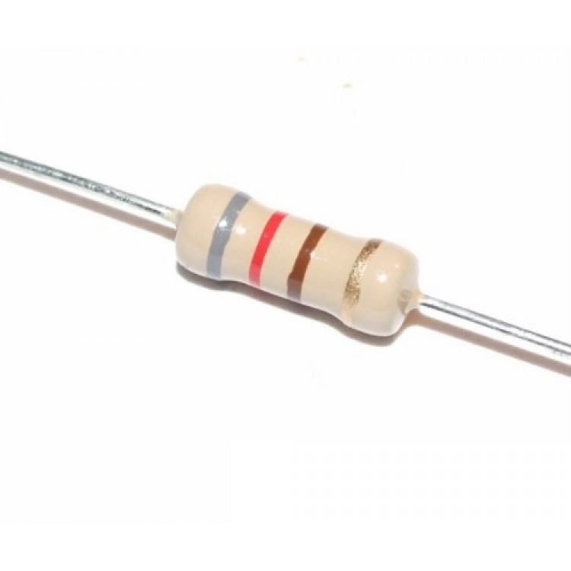

1k 7 Watt Resistor
Device : 7WATT1K
Library : RESISTORS
Price : 1 /-
Description : 1K 7W Resistor (Maplin Stock Code = L1K)

Slide 10
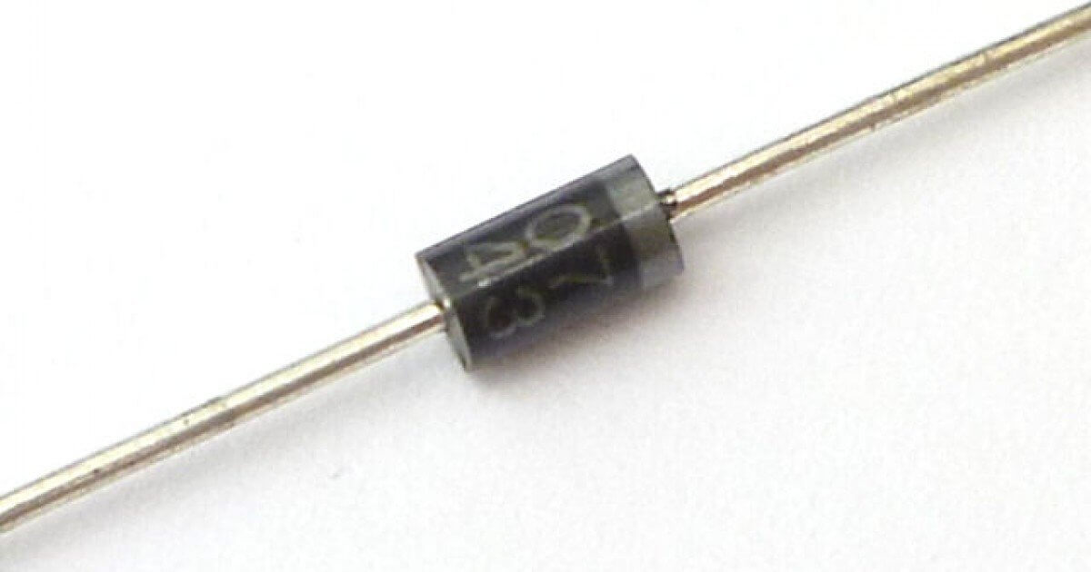

Diode
Device : 1N4007
Library : DIODESINC
Price : 2 /-
Description : Silicon Diode, 1.00kV 3.00us

Slide 11
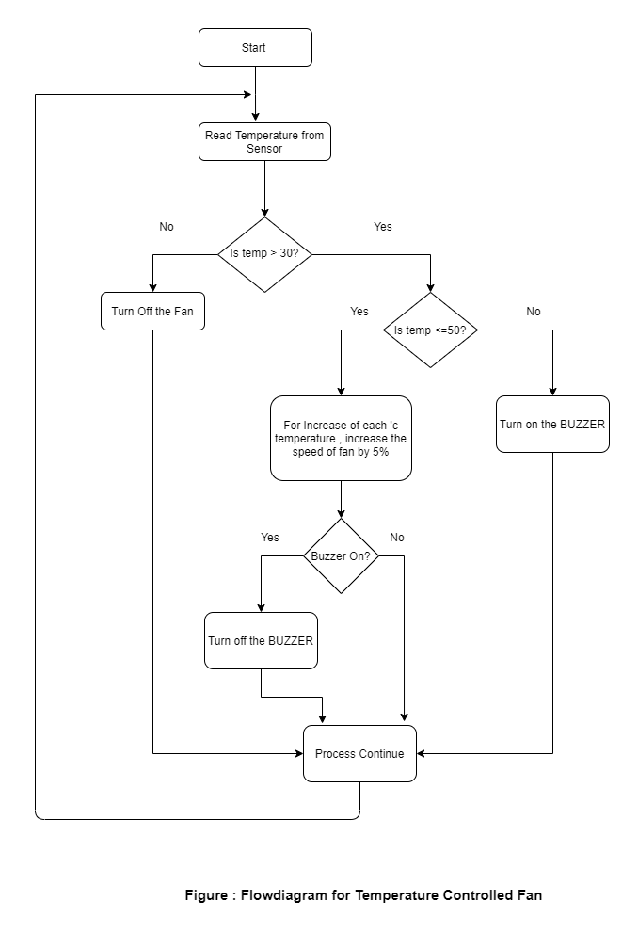

Slide 12
Work Procedure
LM35 Temperature Sensor: LM35 is a precession Integrated circuit Temperature sensor, whose output voltage varies, based on the temperature around it. It is a small and cheap IC which can be used to measure temperature anywhere between -55°C to 150°C.
This sensor has three pins. Pin no 1 is for Vcc , Pin no 2 Vout , Pin no 3 is for connection with ground. We have connected Vcc with 5v power source, Output is connected with 10uF capacitor so that fluctuation can be controlled . The signal is attached with A0 pin. The temperature sensor will give Analog Reading of temperature.

Slide 13
Work Procedure
Arduino Uno R3 :The Arduino Uno R3 is a microcontroller board based on a removable, dual-inline-package (DIP) ATmega328 AVR microcontroller. It has 20 digital input/output pins (of which 6 can be used as PWM outputs and 6 can be used as analog inputs).
This sensor will run our main program. So if we need to talk about it’s contribution in the project we mostly need to talk about the program.
Program for converting analog temperature into ‘c :
int readTemp() {
temp = analogRead(tempPin);
return temp * 0.48828125;
}
We need to multiply the analog temperature with a factor of (5 / 10.24) to make it in Celsius.

Slide 14
Work Procedure
It’s Digital pin 13 is connected with Buzzer .
And Digital Pin 4,5,6,7 is connected to 16 X 2 LCD display to show calculated temperature and fan speed and display them.
We are taking Minimum temperature as 30’c and Maximum temperature as 50’c .
If the temp is less than Min temp
if(temp < tempMin) {
fanSpeed = 0;
digitalWrite(fan, LOW);
}

Slide 15
Work Procedure
If the temp is Grearer than Max temp
if(temp > tempMax) {
digitalWrite(fan, HIGH);
digitalWrite(buzzer, HIGH);
}
If the temp is in the Range(31-50)
if((temp >= tempMin) && (temp <= tempMax)) {
fanSpeed = map(temp, tempMin, tempMax, 32, 255);
fanLCD = map(temp, tempMin, tempMax, 0, 100);
analogWrite(fan, fanSpeed);
}

Slide 16
Work Procedure
16 X 2 LCD Display : The 16×2 LCD display is a very basic module commonly used in DIYs and circuits. The 16×2 translates o a display 16 characters per line in 2 such lines. In this LCD each character is displayed in a 5×7 pixel matrix.
It has 14 pins.
Pin 1 is connected Ground.
Pin 2 is connected with 5v power source.
Pin 3 is for Contrast. We can change the brightness of display by this. That is why it is connected with 10k Ohm Potentiometer.
Pin 4 , 5, 6 are for Register Select, Read/Write and for Enable. Pin 4 is connected with pin 2 of Arduino, pin 5 is connected with ground & pin 6 is connected with pin 3 of Arduino.

Slide 17
Work Procedure
The rest 8 pins are for Display Purpose. As we are printing here in 4 bit data pattern that’s why we keep D0 ,D1 ,D2 ,D3 disconnected. Pin D4 , D5 , D6 , D7 will connect with Digital pin 4,5,6,7 of Arduino respectively.
DC Fan : Digital Pin 11 is connected to Gate of Mosfet through 100 Ohm resistance . Gate is cooled down by connecting 10k resistance . Source is connected with ground. Native output is going to fan through drain. Fan is powered by 5v . Diode is connected for reverse biasing.

Slide 18
Features
Detect Temperature of the Surroundings
Display the Temperature
Controlling the Speed of the Fan Depending on the Temperature
Buzzer Sound to Make Alert People if the Temperature is Upon a certain limit.

